Slide 1

WarShips
About our code
Essence
In the future
Team slide
Technologies used
Our goal

Slide 2
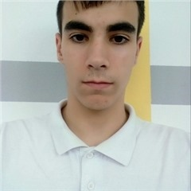
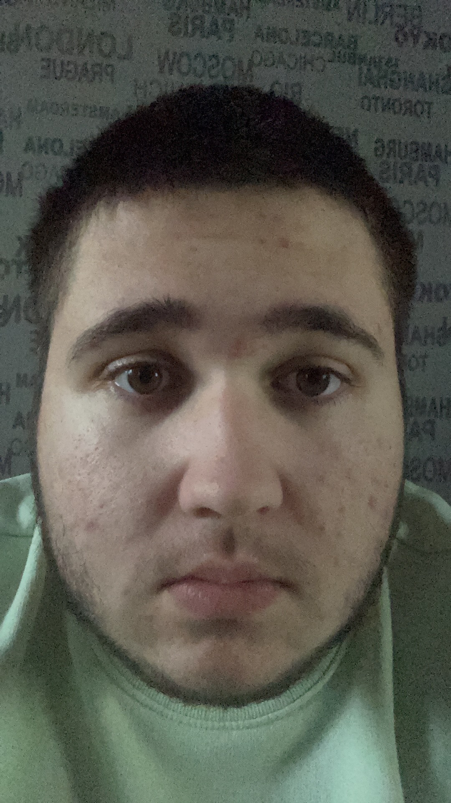
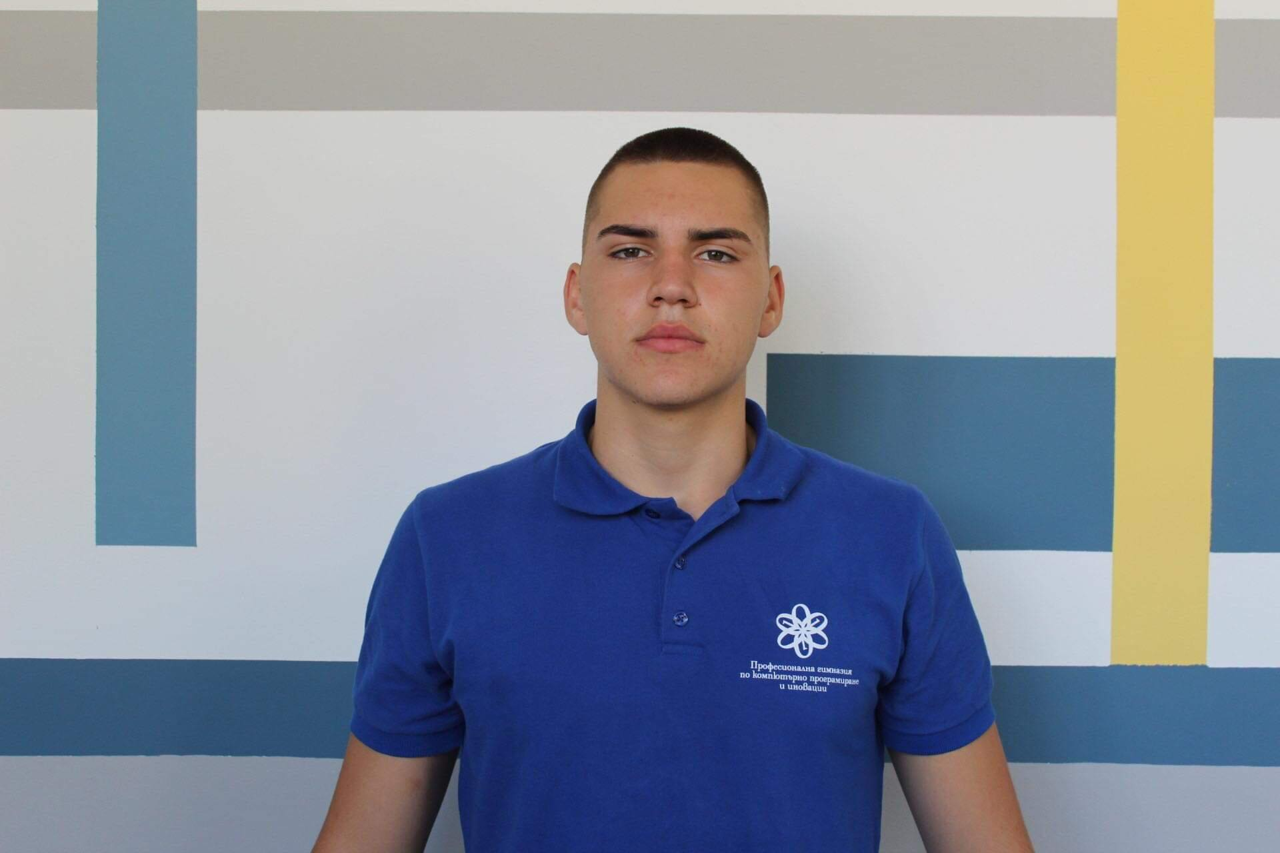

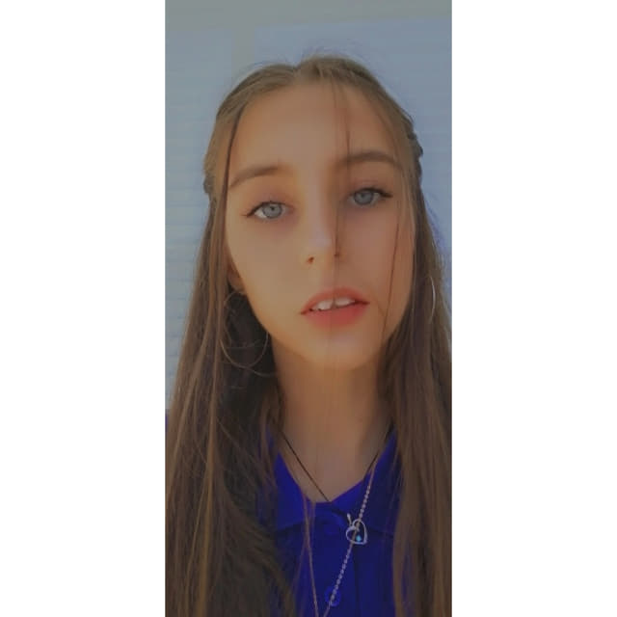
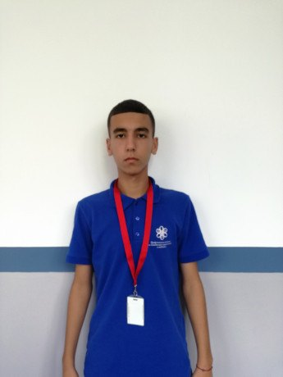

Team slide
Todor Bozhinov
Dimitar Dyakov
Iliya Marinov
Patar Petkov
Krasiyana Kamburova
Stanislav Todorov

Slide 3

Our goal:
What do we want to create?
What it is based on?
Let’s move on the next slide

Slide 4
Only thirteen moves
Four random numbers
Essence of application
“Guessed numbers”
“Guessed numbers and positions”

Slide 5





Technologies used:

Slide 6
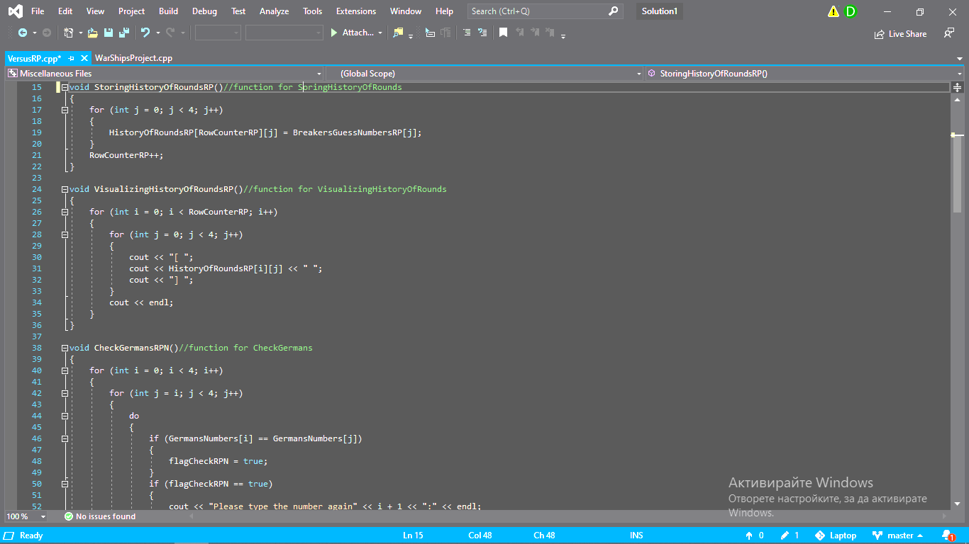
About our code

Slide 7




What are we planning for the features?

Slide 8


